Slide 1

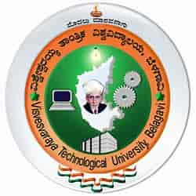
GESTURE CRAFT SLIDER
RNS INSTITUTE OF TECHNOLOGY
BENGALURU - 98
DEPARTMENT OF INFORMATION SCIENCE & ENGINEERING
Final Year Project Phase I Part A Presentation
JEEVAN NY 1RN20IS064
KARTHIK P 1RN20IS072
MAITHREYA TM 1RN20IS083
S PRAJWAL 1RN20IS128
Dr. Sunitha K
Assistant Professor
Dept of ISE, RNSIT
Dr. Bhagyashree Ambore
Associate Professor
Dept of ISE, RNSIT

Slide 2

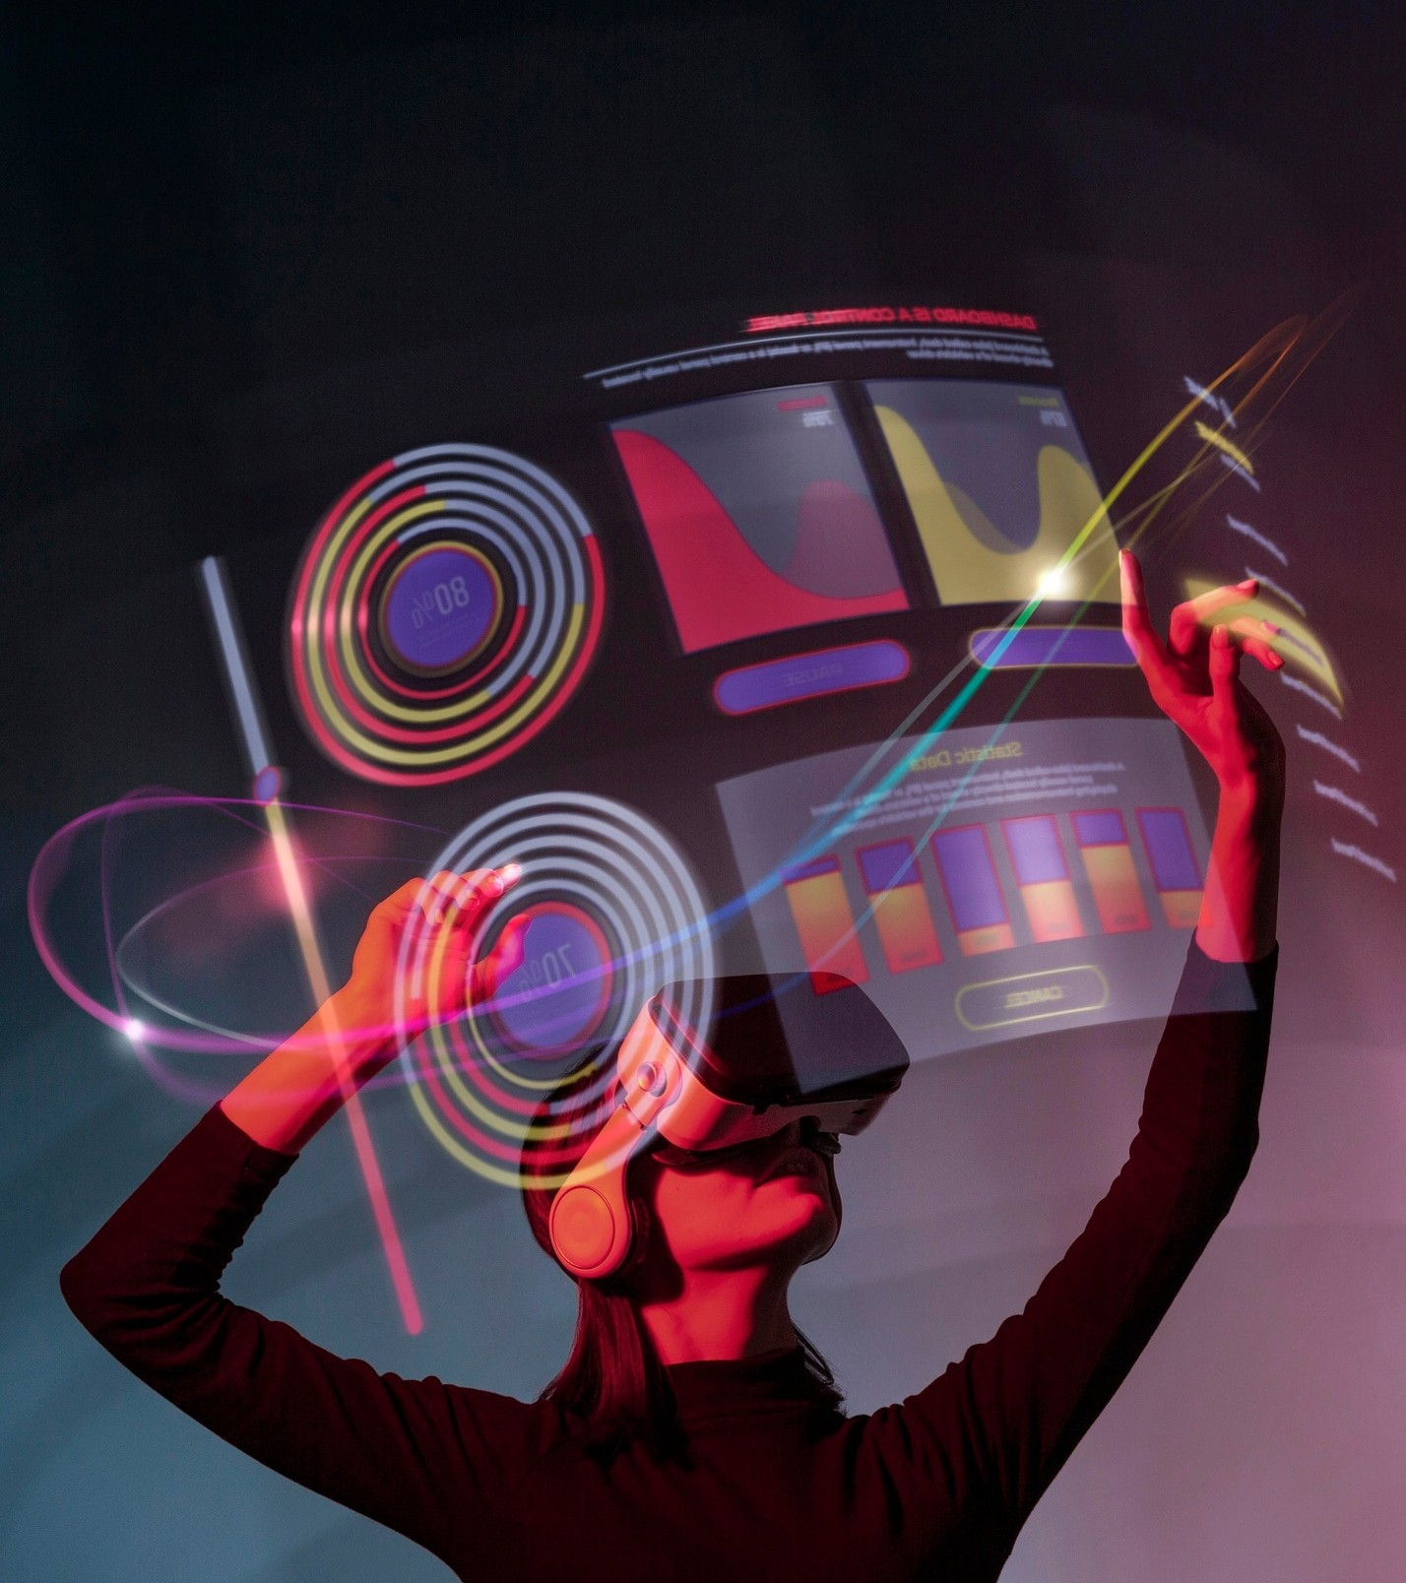
AGENDA
Introduction to Domain
Problem Statement
Abstract
Objectives
Algorithms
QnA
Conclusion
References

Slide 3

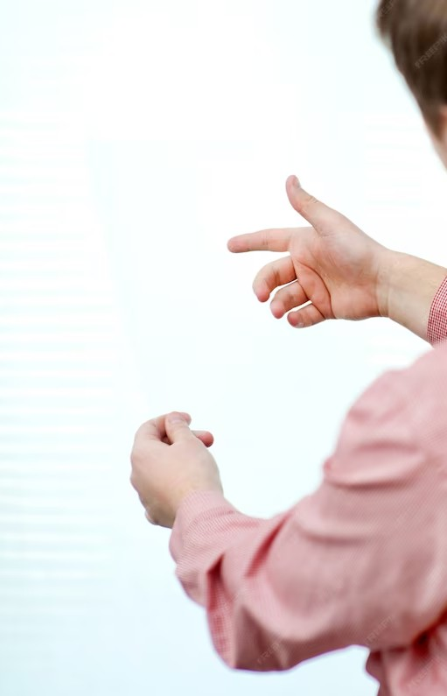
Revolutionizing Presentations: Harnessing the Power of Hand Gestures with OpenCV

Slide 4
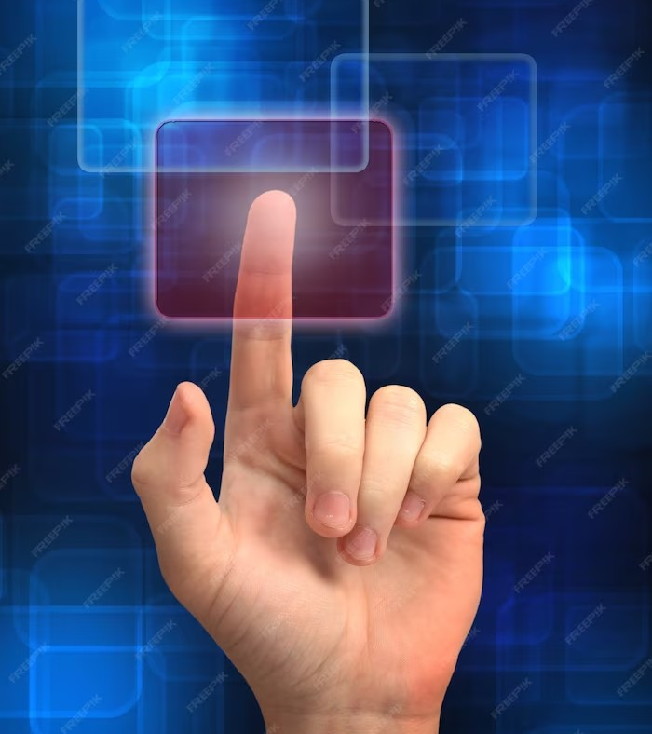
Understanding OpenCV
OpenCV is an open-source computer vision library that provides a wide range of tools and algorithms for. It enables us to detect and track hand gestures by analyzing the video feed from a camera. With its extensive documentation and support for multiple programming languages, OpenCV makes it easier than ever to leverage the power of hand gestures in presentations.
Notes:
Introduction to OpenCV

Slide 5
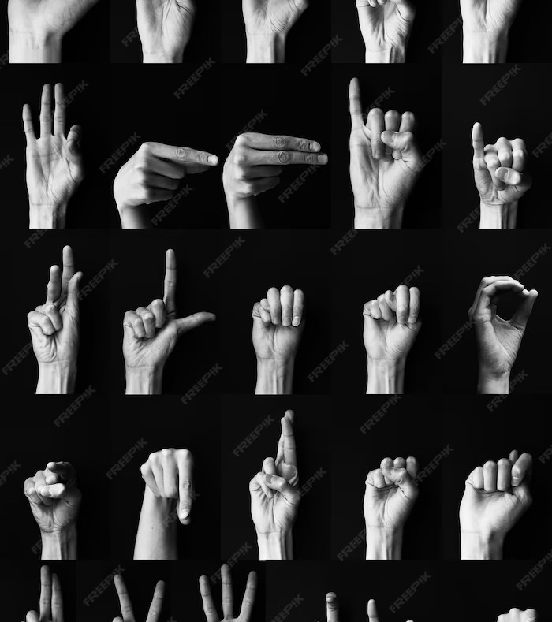
Abstract
This project introduces an innovative solution to enhance presentation experiences by integrating OpenCV, a robust computer vision library, with hand gesture recognition technology. This system utilizes a standard webcam to detect and interpret hand gestures, allowing presenters to effortlessly navigate slides, emphasize key points, and engage with their audience without conventional input devices. Key features include real-time hand tracking, gesture recognition, and a user-friendly interface that seamlessly integrates with popular presentation software, providing precise control over presentations through intuitive hand gestures such as swipes, taps, and pinches.

Slide 6
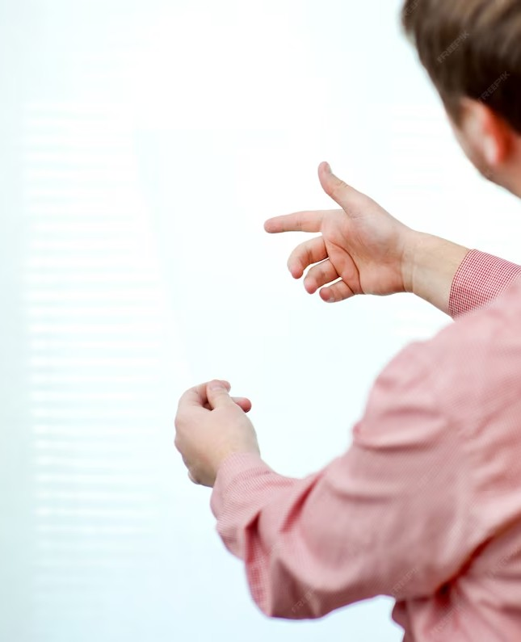
Problem statement
Traditional methods of controlling presentations, such as using remote clickers or keyboard shortcuts, often hinder the flow and engagement of presentations. These methods require presenters to divert their attention from the audience to control their slides, resulting in a less interactive and dynamic presentation experience. Additionally, in the context of virtual presentations, the lack of physical presence further exacerbates these challenges.

Slide 7
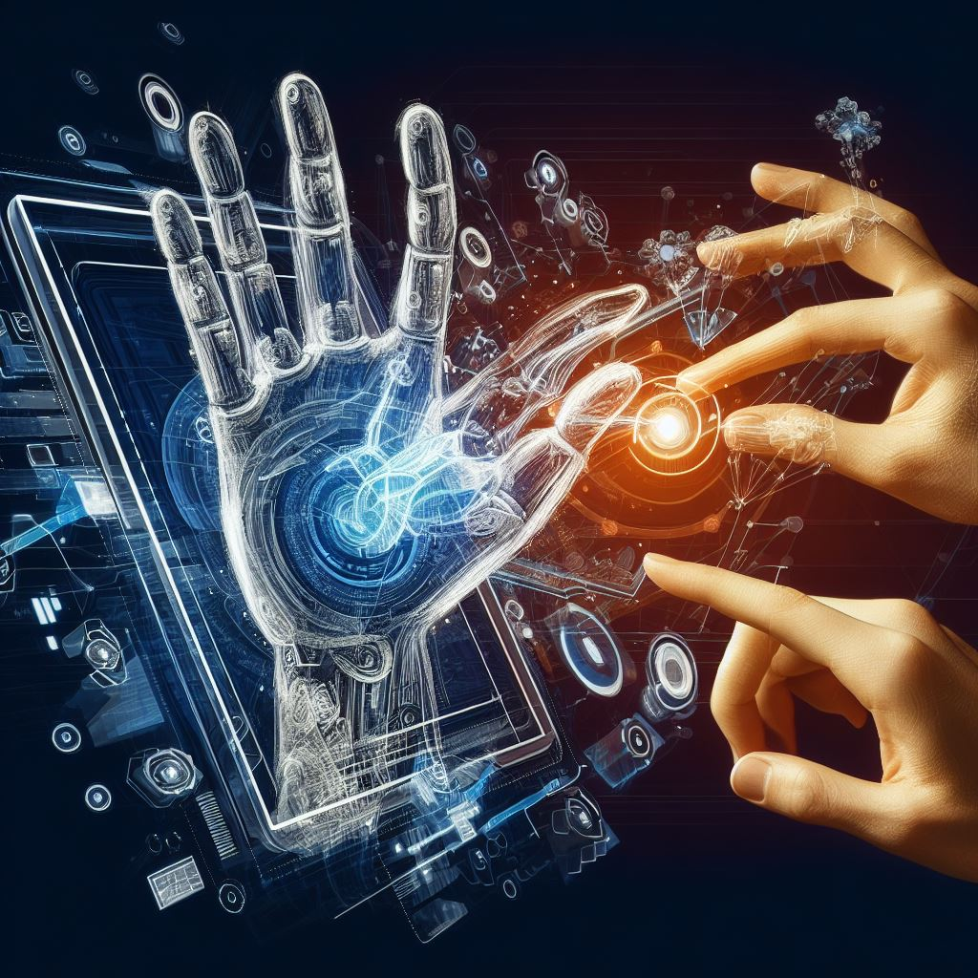
Algorithmic Approaches
Convolutional Neural Networks (CNNs): CNNs excel at learning and recognizing complex hand gestures from image data, making them a powerful choice for gesture recognition.
Optical Flow: Optical flow algorithms can track the motion of key points within a hand gesture, facilitating the interpretation of dynamic gestures.
Background Subtraction: This method separates the hand (foreground) from the background, crucial for isolating the hand for gesture recognition.
Kalman Filters: Kalman filters help track the position of the hand over time, reducing noise and improving the accuracy of gesture recognition.

Slide 8
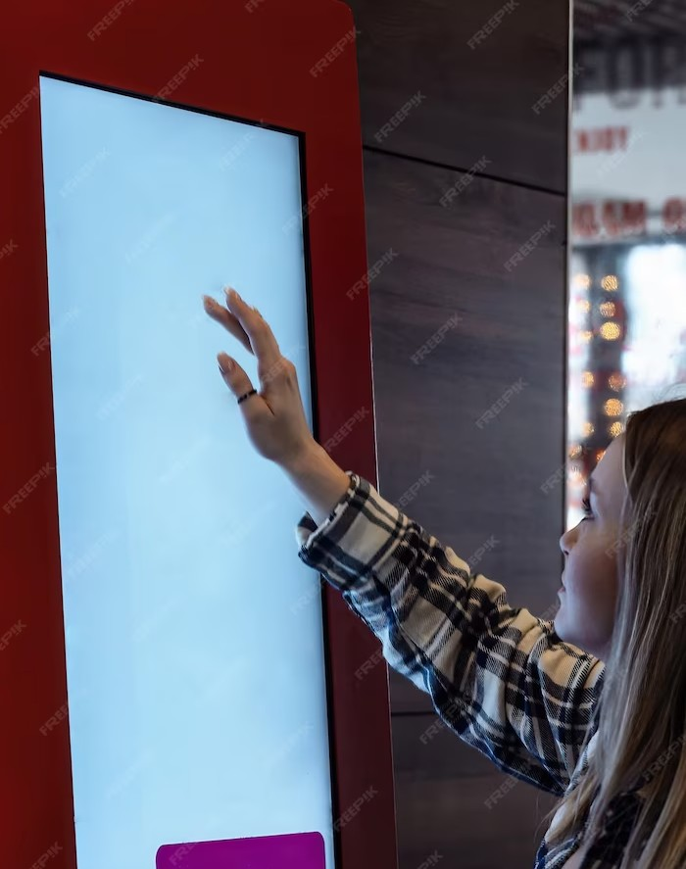
Objective
Integration with Presentation Software: Integrate this with popular presentation software like PowerPoint, Google Slides, or Zoom to enable seamless control and interaction during presentations.
User-Friendly Interface: Develop a user-friendly graphical interface that allows presenters to easily customize and calibrate the gesture controls according to their preferences.
This technology has the potential to revolutionize the way we interact with slides, making presentations more dynamic and captivating.

Slide 9

Q&A
Thank you for your attention! Now, let's open the ﬂoor for any questions you may have regarding hand gesture recognition in presentations using OpenCV.

Slide 10
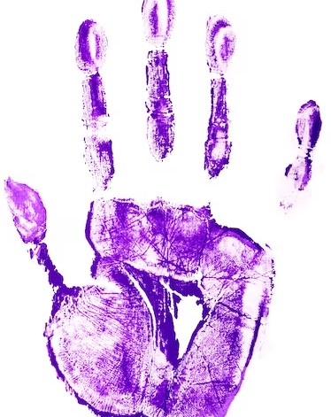
References
https://www.eurchembull.com/uploads/paper/e1872b82f7272d54308f653ddd1fc741.pdf
https://opencv.org
https://paperswithcode.com/paper/
https://www.w3schools.com/python/
https://medium.com/better-programming/hagrid-hand-gesture-recognition-image

Slide 11
Conclusion
In conclusion, hand gestures combined with OpenCV have the potential to revolutionize presentations. By incorporating this technology, presenters can create a more interactive and engaging experience for their audience. From controlling slides, hand gestures offer a powerful non-verbal communication channel. Embrace the power of hand gestures and take your presentations to new heights!

Slide 12
Thanks!

